Slide 1


Radiance Sky Image-Based Cloud Shadow Mapping for Solar Energy Forecasting
Chengdu University of Technology, Oxford Brookes Graduate Project Presentation & Defense
Author: Linrui Dong Supervisor: Happy Nkanta Monday

Slide 2
Introduction & Background
1
Contents
2
Methodology and Approach
3
Results and Deployment
4
Conclusion & Future Work

Slide 3
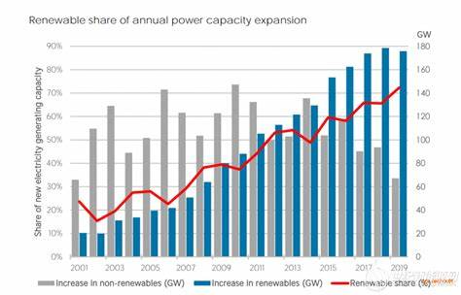
>> Background & Introduction
Global PV Growth Challenge
720 TWh generated in 2019 (22% increase)
Cloud shadows cause up to 80% power drop
Grid stability issues from intermittency
Need for accurate short-term forecasting
20-year PV growth rate(%), 2001-2019
Global PV growth

Slide 4
>> Background & Introduction
Traditional Forecasting Limitations:
1.Numerical Weather Prediction (6+ hours)
2. Physical models fail on complex patterns
3.-Limited accuracy for 5-30 minute horizon
Deep Learning Solution:
1.CNN-LSTM Hybrid Architecture
2.Attention Mechanism
3.Sky Image Analysis

Slide 5
>> Research Objectives
Develop CNN-LSTM hybrid model for cloud shadow mapping
Achieve accurate short-term (5-30 min) solar irradiance prediction
Implement attention mechanism for improved feature extraction
Create web-based deployment for real-time forecasting
Enhance grid stability and renewable energy integration

Slide 6
>> Dataset & Methodology
Data Split:
Wollongong Dataset:
3 locations at University of Wollongong, Australia
Sky images (1024×768 pixels)
10-second intervals, 8:00 AM - 4:45 PM
Paired with PV power measurements

Slide 7
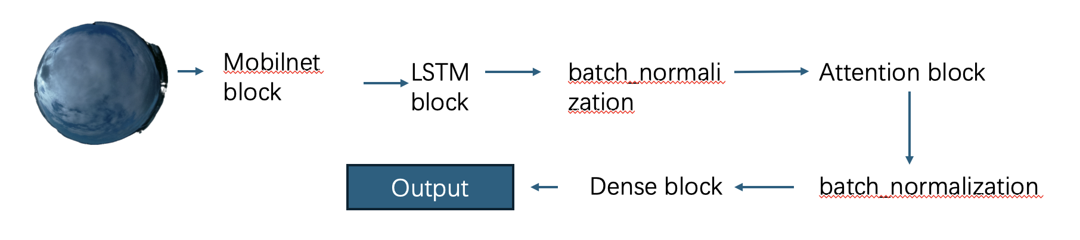
>> Proposed Model Architecture
Key Components:
MobileNet: Efficient spatial feature extraction
LSTM: Temporal sequence modeling - Attention: Focus on relevant cloud features
Batch Normalization: Training stability

Slide 8
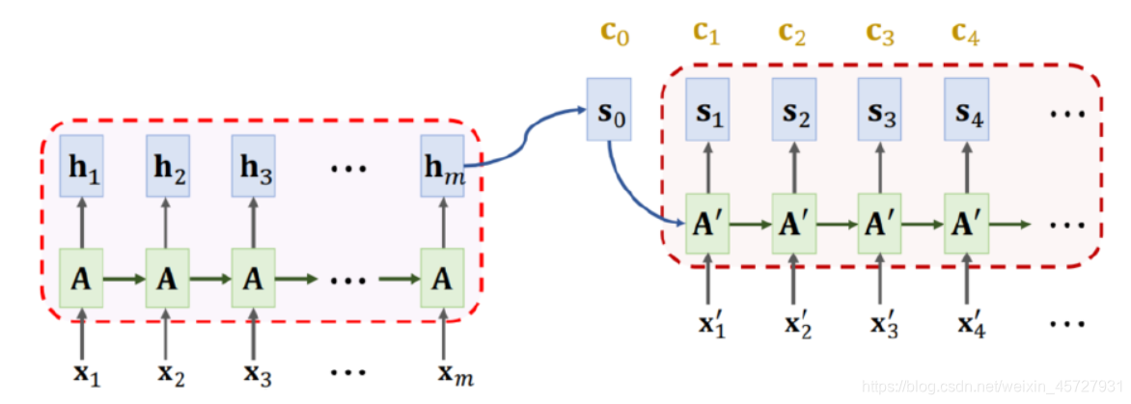
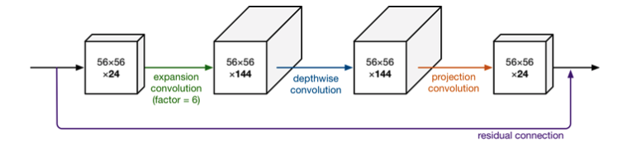
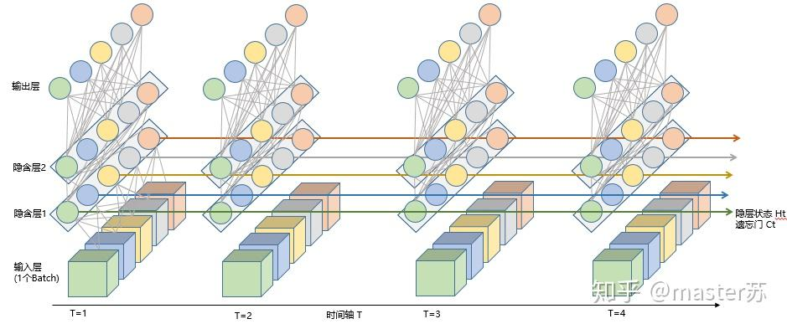
>> Model Architecture Details
Attention Mechanism: - Custom attention layer
Context vector computation
Region-based weighting
MobileNet Features:
Input: 256×256×3
Output: 8×8×1280 feature maps
Depthwise separable convolutions
LSTM Configuration:
64 hidden units
Dropout: 0.3
Sequence length: 10 frames

Slide 9
>> Training Process
Optimization:
Adam optimizer (lr=0.001)
MSE loss function
Early stopping (patience=15)
Learning rate reduction
Regularization:
Dropout layers (0.3)
Batch normalization
Data augmentation
L2 regularization

Slide 10
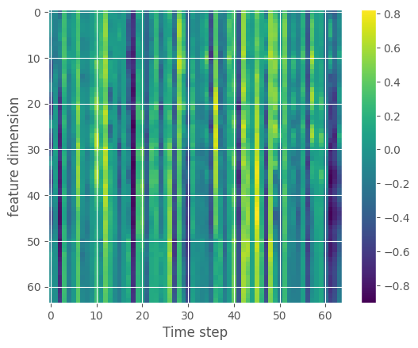
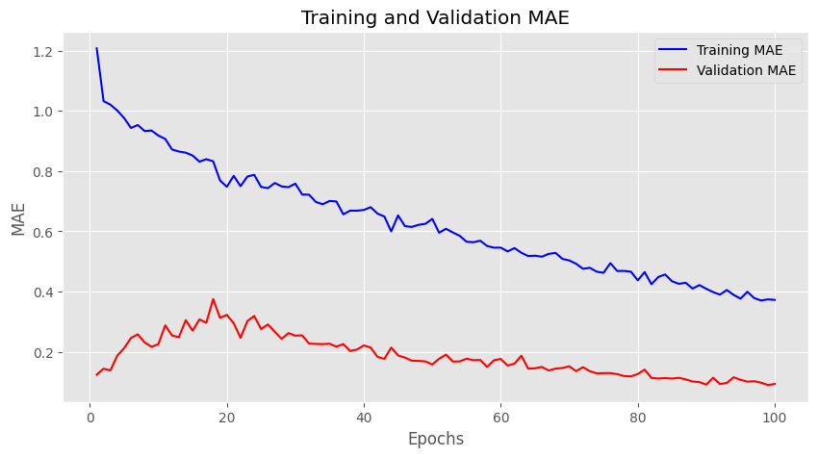
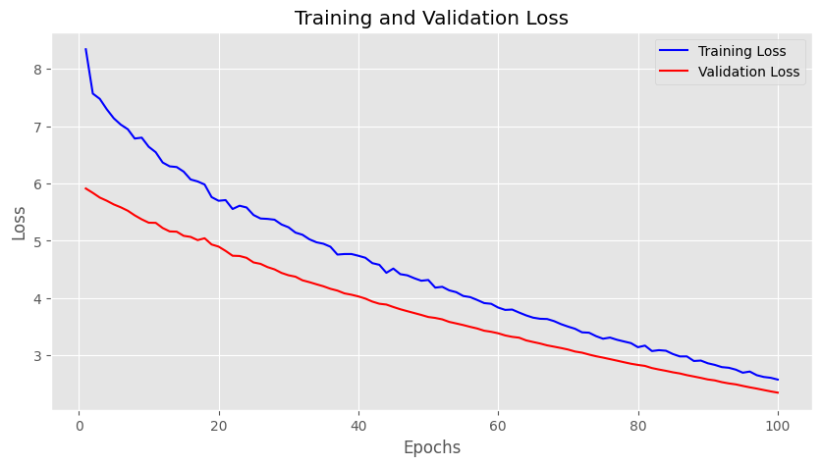
>> Results of the Proposed Model
Model MAE
Validation MAE = 0.0032
Model Loss Validation Loss = 0.0869
Feature dimension
Performance Metrics:
MSE: 0.0032
MAE: 0.042
MAPE: 17.48%
RMSE: 0.0565
R²: 0.992

Slide 11
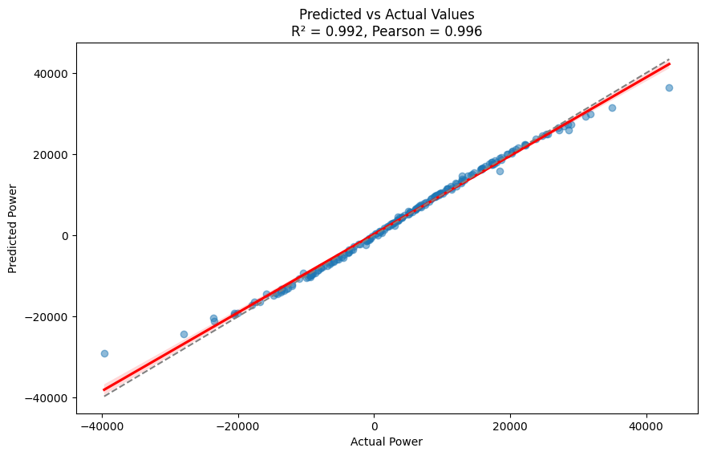
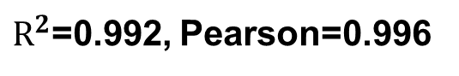
>> Results of the Proposed Model (cont’d)
$R^{2}$=0.992, Pearson=0.996

Slide 12
>> Comparison Analysis of the Proposed Model
Model | MSE | MAE | MAPE
CNN | 0.0189 | 0.6109 | 314.19%
LSTM | 0.0428 | 1.0986 | 438.62%
CNN-LSTM | 0.0057 | 0.0639 | 28.75%
Proposed Model | 0.0032 | 0.042 | 17.48%
Comparison Analysis with Previous Work

Slide 13
>> Comparison Analysis of the Proposed Model (cont’d)
Model | MSE | MAE | MAPE | RMSE | R²
Proposed model | 0.0032 | 0.042 | 17.48% | 0.0565 | 0.992
CNN-LSTM (without attention) | 0.0057 | 0.0639 | 28.75% | - | -
5-layer CNN-LSTM 5 层 CNN-LSTM[1] | 0.006897 | 0.05193 | - | 0.08304 | -
CNN-LSTM[2] | - | - | - | 0.07 | 0.92
CNN-LSTM-RF[3] | - | 0.05 | - | 0.07 | 0.92
CNN-SLSTM (optimized)[4] | - | - | 5.4315% | 6.4124% | 0.9348

Slide 14

>> Web Application Deployment
Image Uploading Zone Uploading

Slide 15
>> Key Contributions
Novel CNN-LSTM hybrid architecture with attention mechanism
Achieved 80%+ improvement over standalone models
Successful deployment for real-time forecasting
Contribution to renewable energy integration
Open-source implementation available

Slide 16
>> Conclusion
Successfully developed hybrid deep learning model
Achieved high accuracy (R² = 0.992)
Demonstrated effectiveness across weather conditions
Practical deployment completed
Significant advancement in solar forecasting

Slide 17
>> Future Work
Expand dataset to multiple geographical locations
Integrate satellite imagery for enhanced coverage
Extend prediction horizon to medium-term
Implement ensemble methods
Edge deployment optimization
Integration with smart grid systems

Slide 18
>> Reference
[1] S. Tajjour et al., "Short-Term Solar Irradiance Forecasting Using Deep Learning," IEEE Access, 2023.
[2] Yang et al., "Solar Energy Forecasting: A Review," Energy Conversion and Management, 2018.
[3] Inman et al., "Solar Forecasting Methods for Renewable Energy Integration," Progress in Energy, 2013.
[4] Chow et al., "Sky Imaging for Solar Forecasting," Solar Energy, 2011.
[5] Y. Pi et al., "Short-term Solar Irradiation Prediction Model Based on WCNN_ALSTM," in IEEE International Conference on Dependable, Autonomic and Secure Computing, 2021, pp. 405-412, doi: 10.1109/DASC-PICom-CBDCom-CyberSciTech52372.2021.00075.
[6] L. Cheng et al., "Short-term Solar Power Prediction Learning Directly from Satellite Images With Regions of Interest," IEEE Transactions on Sustainable Energy, vol. 13, no. 1, pp. 629-639, 2022, doi: 10.1109/TSTE.2021.3123476.
[7] Y. Xu et al., "Cloud Displacement Vector Calculation in Satellite Images Based on Cloud Pixel Spatial Aggregation and Edge Matching for PV Power Forecasting," in IEEE Sustainable Power and Energy Conference (iSPEC), 2020, pp. 112-119, doi: 10.1109/iSPEC50848.2020.9351115.
[8] P. M. P. Garniwa et al., "Intraday forecast of global horizontal irradiance using optical flow method and long short-term memory model," Solar Energy, vol. 252, pp. 234-251, 2023, doi: 10.1016/j.solener.2023.01.037.
[9] Z. Si et al., "Hybrid Solar Forecasting Method Using Satellite Visible Images and Modified Convolutional Neural Networks," IEEE Transactions on Industry Applications, vol. 57, no. 1, pp. 5-16, 2021, doi: 10.1109/TIA.2020.3028558.
[10] L. Dissawa et al., "Sky Images and PV Power Measurements for Irradiance Forecasting," Mendeley Data, V2, 2021, doi: 10.17632/cb8t8np9z3.2.

Slide 19
Thank You

